Slide 1
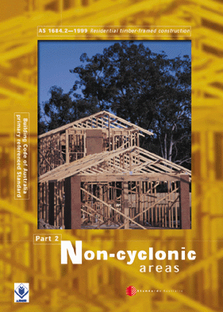
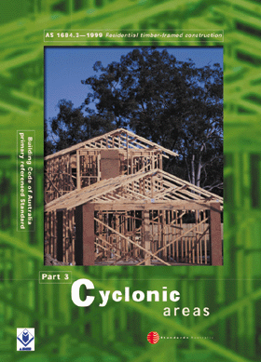
SECTION 1 -
SCOPE AND GENERAL

Slide 2
1.1 SCOPE
This Standard specifies requirements for building practice and the selection, placement and fixing of the various structural elements used in the construction of timber-framed Class 1 and Class 10

Slide 3
Building Classes
Class 1(a) - Detached house
Attached dwellings
(Terrace houses, Villas etc.)
Class 1(b) - Boarding house
• not more than 300 sq. mtrs
• not more than 12 residents
Class 10 - Outbuildings
(garages, carports etc.)

Slide 4
Other Building Classes
Class 2 - Building containing 2 or more
sole occupancy units.
Class 3 - Boarding house, Guest house etc.
    • For aged, disabled, children
    • Residential part of hotel, motel,
    school, health care building.
Class 4 - The residential part of a
Class 5,6,7,8,9 building.

Slide 5
Other Building Classes
Class 5 - Offices
Class 6 - Shops
Class 7 - Storage, Carparks
Class 8 - Factories, Workshops
Class 9 - Public Buildings

Slide 6
1.6 LIMITATIONS
Generally the limitations given in AS 1684 apply because of the limits of the design information given in AS 1684.
e.g. - the bracing tables given in the standard are limited to a 16 m wide building and 35^{O} roof pitch.

Slide 7
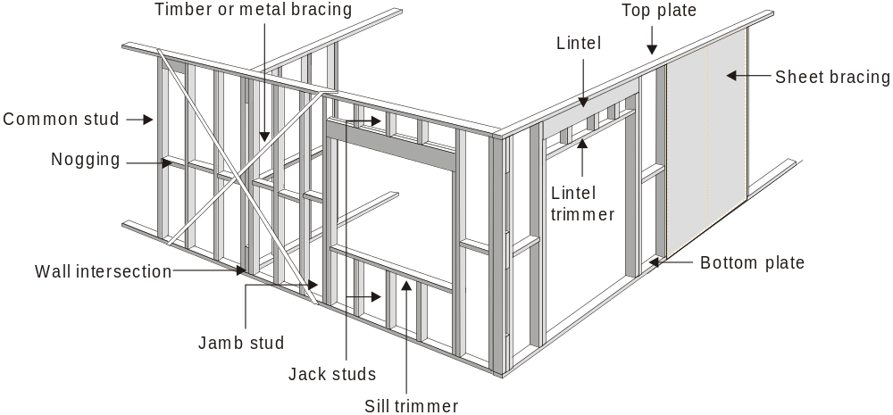
Conventional Frame

Slide 8
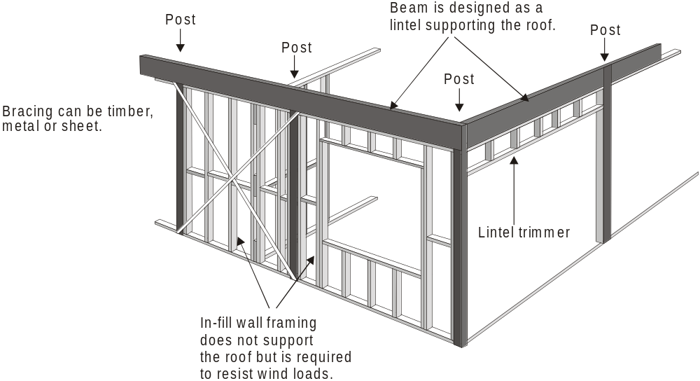
Post & Beam

Slide 9
1.6.2 Wind Classification
Either AS 4055 - Wind Loads for Housing (the simplified wind classification standard) or AS 1170.2 SAA Loading code Part 2 – Wind loads shall be used to determine the wind classification necessary for the use of this Standard.

Slide 10
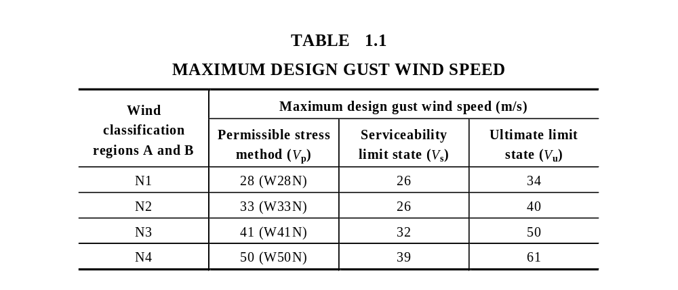
1.6.2 Wind Classification
Non-cyclonic

Slide 11
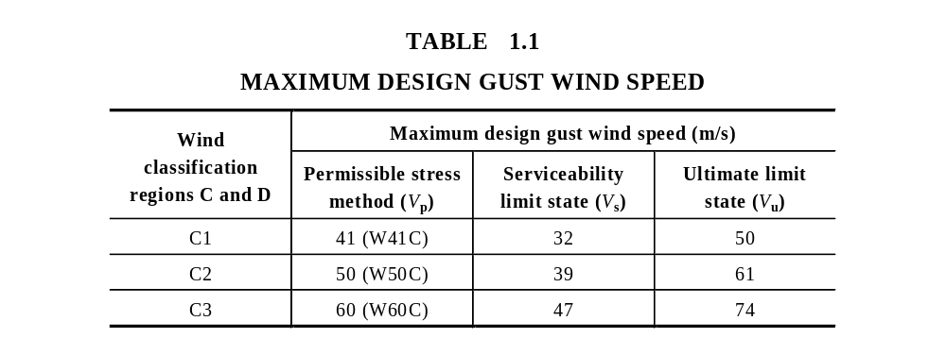
1.6.2 Wind Classification
Table 1.1 - Cyclonic
Cyclonic

Slide 12
1.6.3 Plan
Building shapes shall be essentially rectangular, square, L-shaped or a combination of essentially rectangular elements including splayed-end and boomerang-shaped buildings.
There is no major limitation on the shape of buildings. Exceptions may include dome shaped buildings.

Slide 13
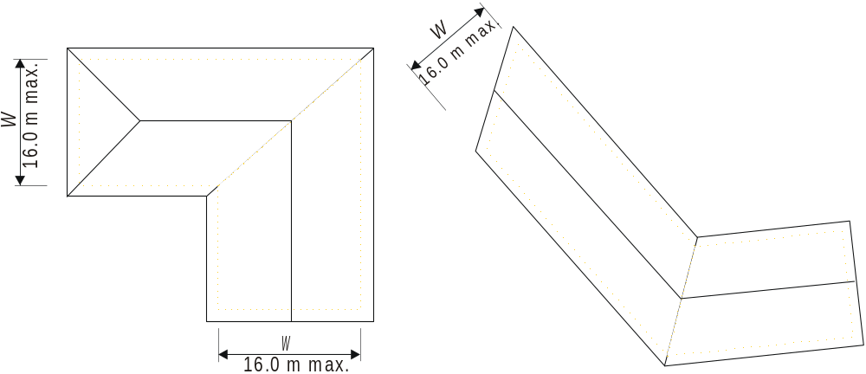
1.6.3 Plan
FIGURE 1.1 (b) Plan

Slide 14
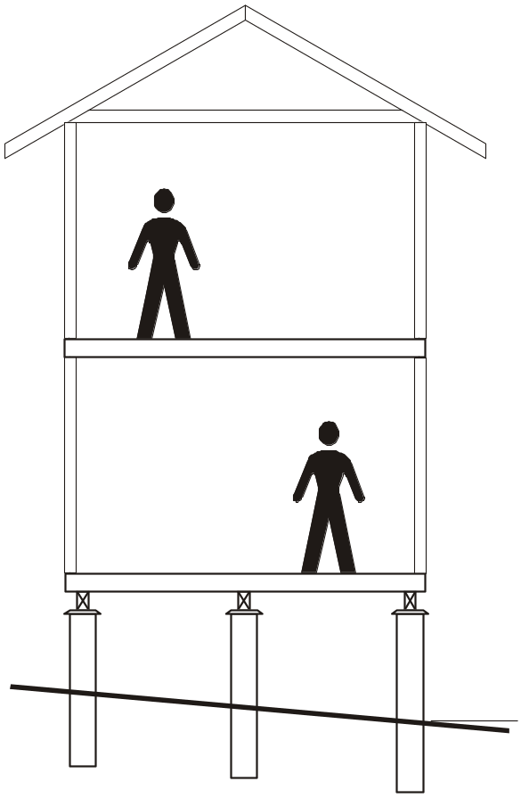
1.6.4 Number of storeys
The maximum number of storeys of timber framing shall not exceed two.
The building shown opposite is considered to be ‘two storeys of timber framing’.
See comments Section 2 - Clause 2.7.8 for more information.

Slide 15
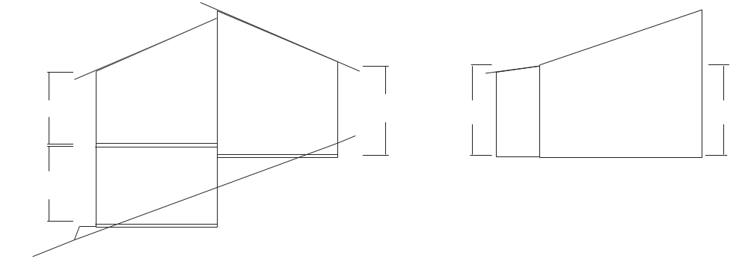
1.6.6 Wall height
The maximum wall height shall be 3000 mm (floor to ceiling) as measured at common external walls, i.e. not gable or skillion ends. (see Figure 1.1)

Slide 16
AS 1684
USER GUIDE
G U I D E T O T H E U S E O F AS 1684
External Wall Heights
from 3.0m to 3.6m
4
The AS1684 User Guide 4 gives the recommended procedure for determining the racking, overturning forces etc. required where wall heights are from 3000 to 3600 mm.

Slide 17
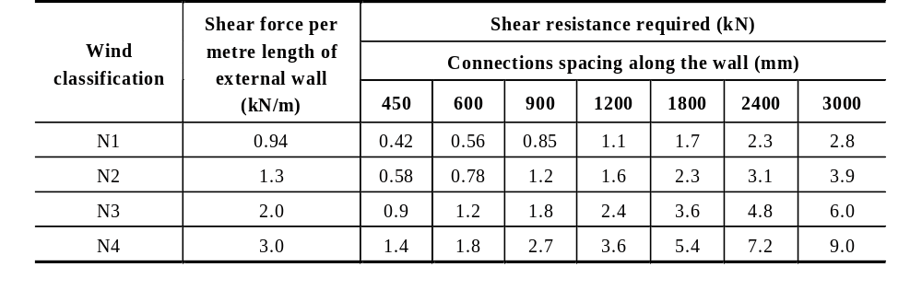
AS 1684
USER GUIDE
G U I D E T O T H E U S E O F AS 1684
External Wall Heights
from 3.0m to 3.6m
4
TABLE 9.29
SHEAR WIND FORCES AT THE TOP OF EXTERNAL WALLS
UP TO 2700 mm HIGH
NOTES: For 3300 mm high external walls, multiply the above values by 1.2.
for 3600 mm high external walls, multiply the above values by 1.3.

Slide 18
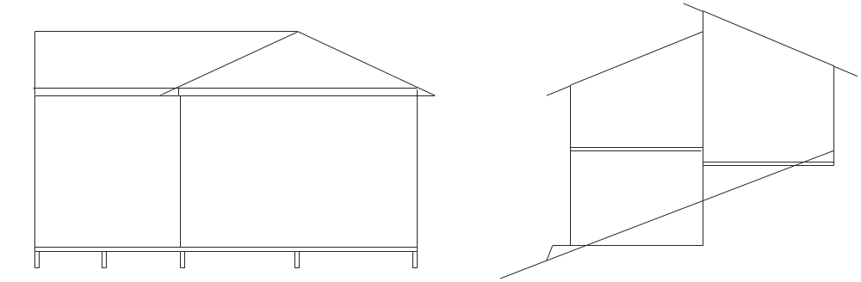
1.6.7 Roof Pitch
The maximum roof pitch shall be 35° (70:100).
35^{O}
35^{O}

Slide 19
1.6.8 Spacing of bracing
For single or upper storey The spacing of bracing elements, measured at right angles to elements, shall not exceed 9000 mm. for N1 & N2. For wind classifications N3, N4, C1, C2 & C3 the spacing of bracing elements is determined in accordance with Clause 8.3.6.7

Slide 20
1.6.9 Roof types
Roof construction shall be hip, gable, skillion, cathedral, trussed or pitched or in any combination of these.

Slide 21
1.6.10 Building Masses
Building masses appropriate for the member being designed shall be determined prior to selecting and designing from the Span Tables in the Supplements.
Where appropriate, the maximum building masses relevant to the use of each member Span Table are noted under the Table.

Slide 22
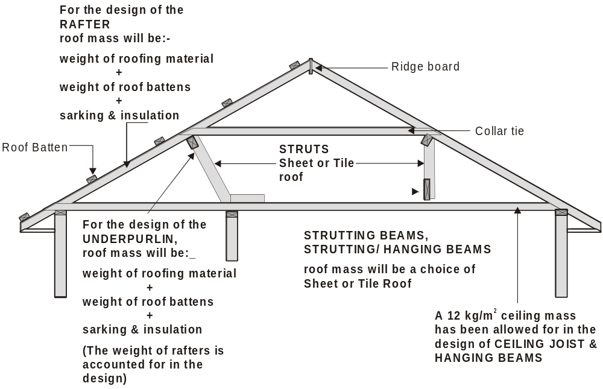

Slide 23
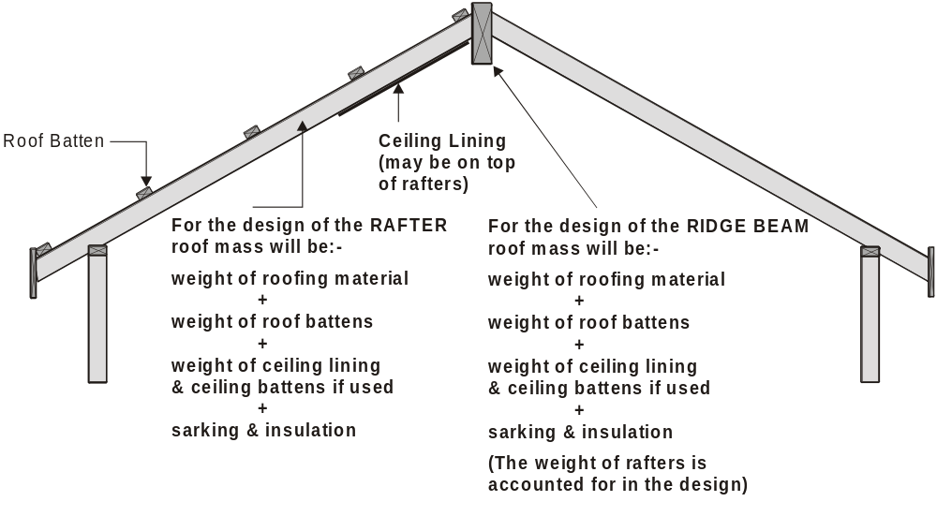

Slide 24
1.8 FORCES ON BUILDINGS
The design of framing members may be influenced by the wind forces that act on the specific members. When using Span Tables in the Supplements, the appropriate wind classification (e.g. N2) together with the stress grade shall be established prior to selecting the appropriate supplement to obtain timber member sizes.

Slide 25
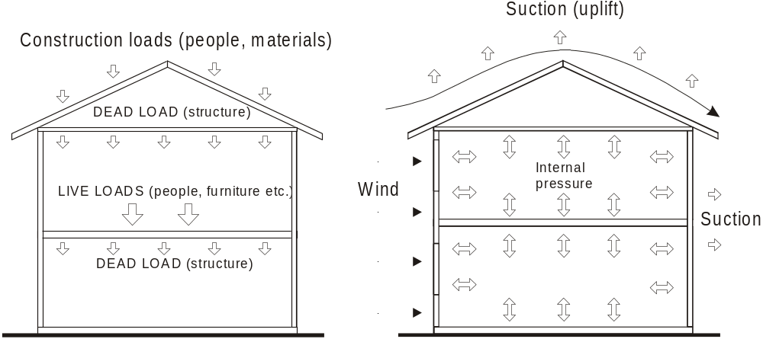
(a) Gravity loads (b) Uplift wind loads
NOTE: For clarity, earthquake and snow loads are not shown (see Clause 1.7 ).
FIGURE 1.2 LOADS ON BUILDINGS

Slide 26
RACKING force is resisted by BRACING.
Racking
(wall deformation)

Slide 27
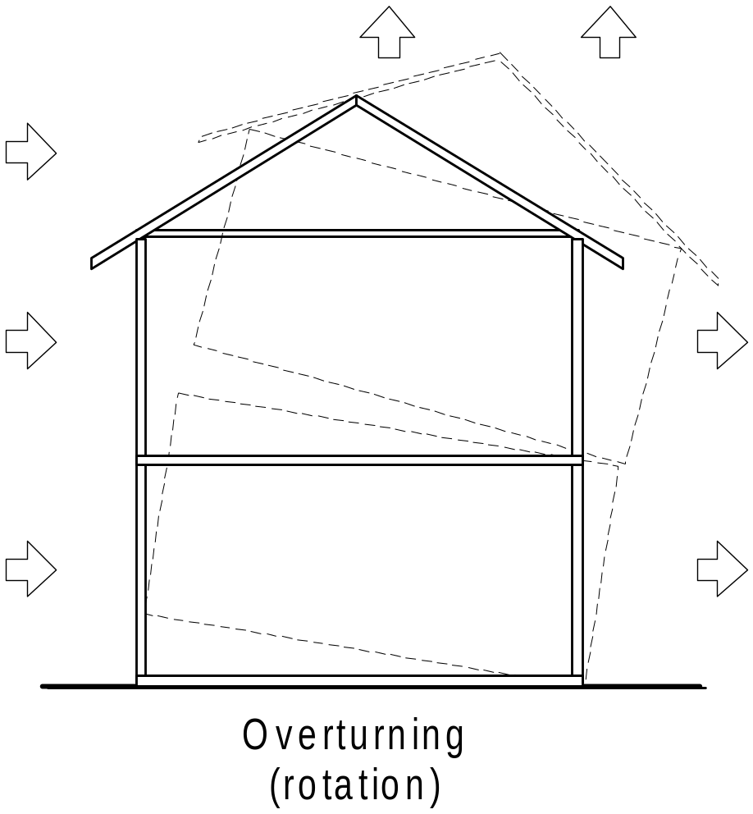
OVERTURNING is resisted by
NOMINAL and/or
TIE-DOWN CONNECTIONS.

Slide 28
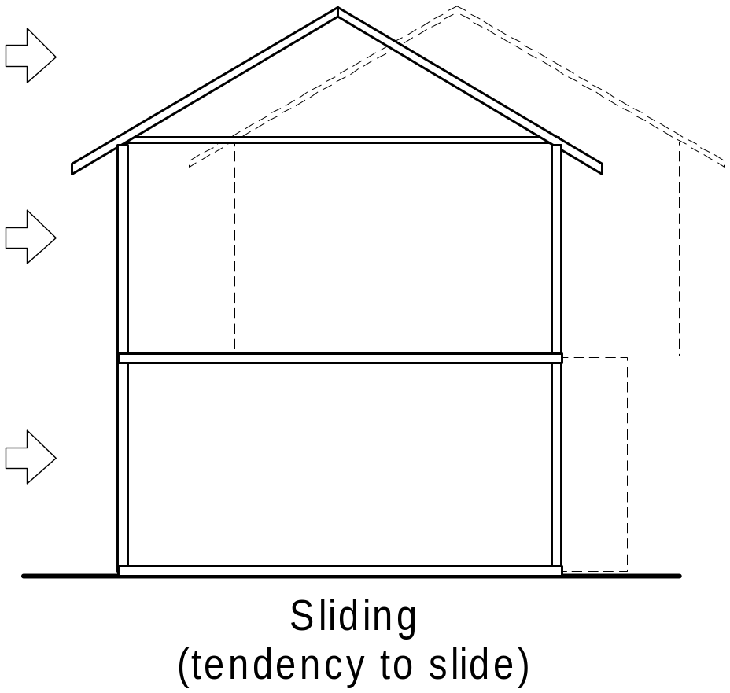
SLIDING (Shear Forces) is resisted by
NOMINAL and/or
TIE-DOWN CONNECTIONS and in some situations extra fixings.

Slide 29
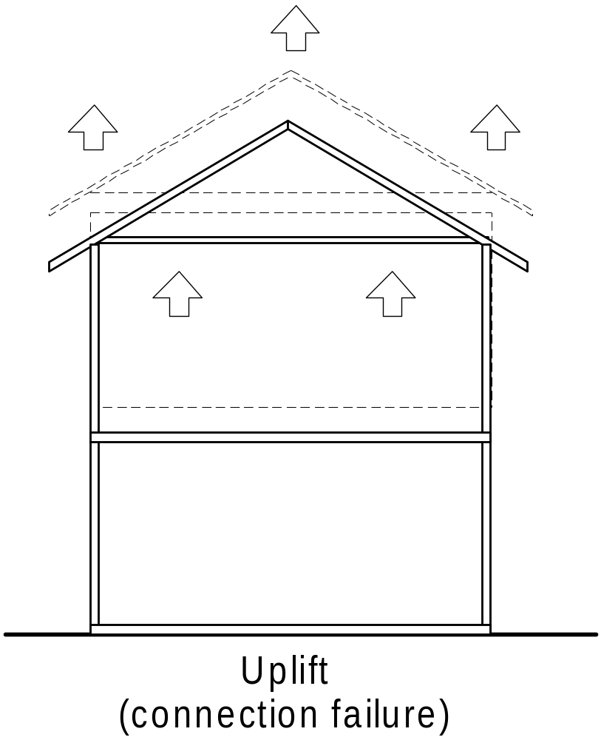
UPLIFT is resisted by NOMINAL and/or
TIE-DOWN CONNECTIONS.

Slide 30
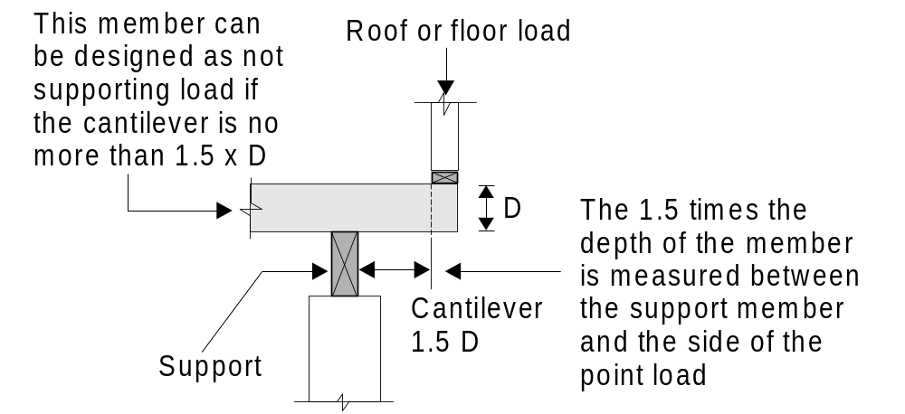
This may be any member that supports roof and/or floor loads

Slide 31
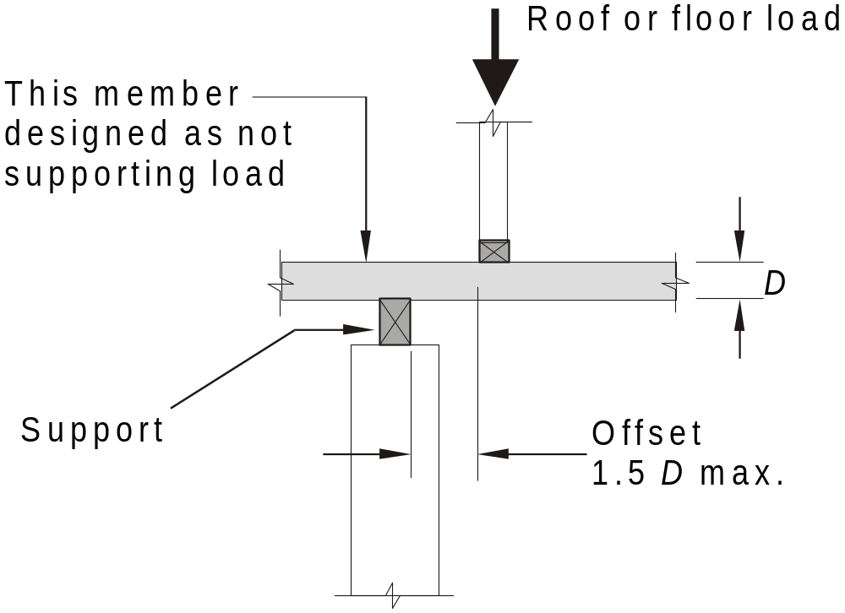
This may be any member that supports roof and/or floor loads

Slide 32
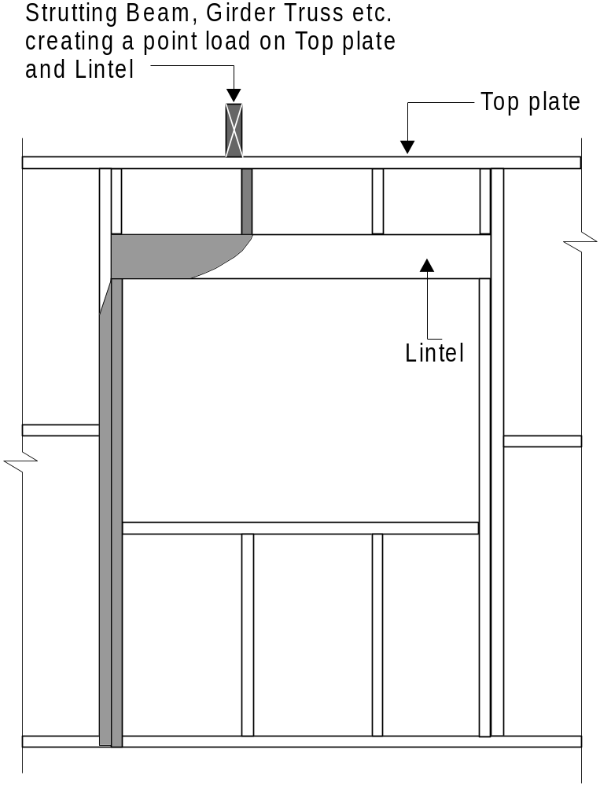
An example of this is where a strutting beam or girder truss is supported by a lintel. This lintel needs to be designed for this point load. The jamb studs will also need to be designed to carry this extra load as well as the structure that supports these jamb studs.

Slide 33
1.10 DURABILITY
Structural timber used in accordance with this Standard shall have the level of durability appropriate for the relevant climate and expected service life and conditions including exposure to insect attack or to moisture which could cause decay.

Slide 34
1.11 DIMENSIONS
Timber dimensions throughout this Standard are stated by nominating the depth (the dimension that carries the load) of the member first followed by its breadth (see Figure 1.6); e.g. 90 × 35 mm (studs, joists etc.), 45 × 70 (wall plates, battens, etc.)

Slide 35
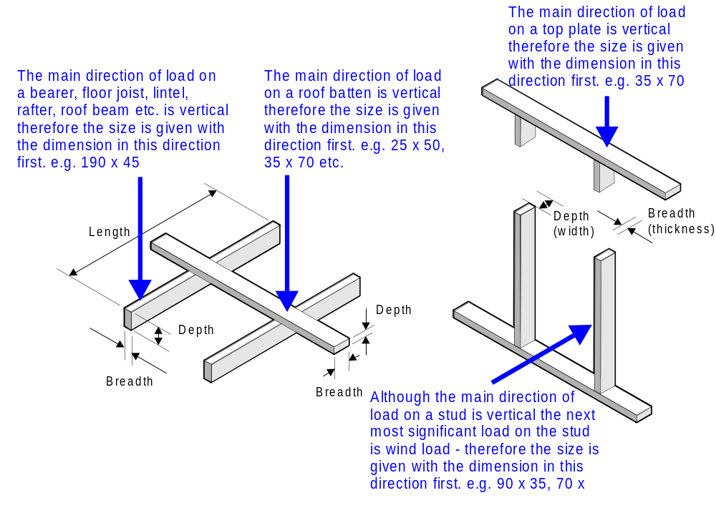

Slide 36
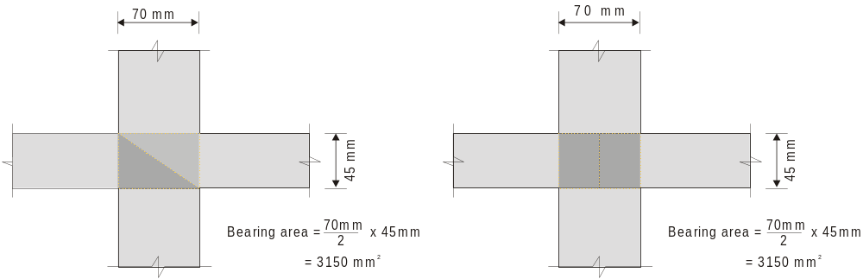
1.12 BEARING
Where the bearing area is achieved using a non-rectangular area such as a splayed joint, the equivalent bearing area shall not be less than that required above.

Slide 37
1.13 STRESS GRADES
Note:
The timber stress grade is usually designated alphanumerically (e.g. F17, MGP12). Stress grades covered by Span Tables in the Supplements to this Standard are given in Table 1.2.

Slide 38
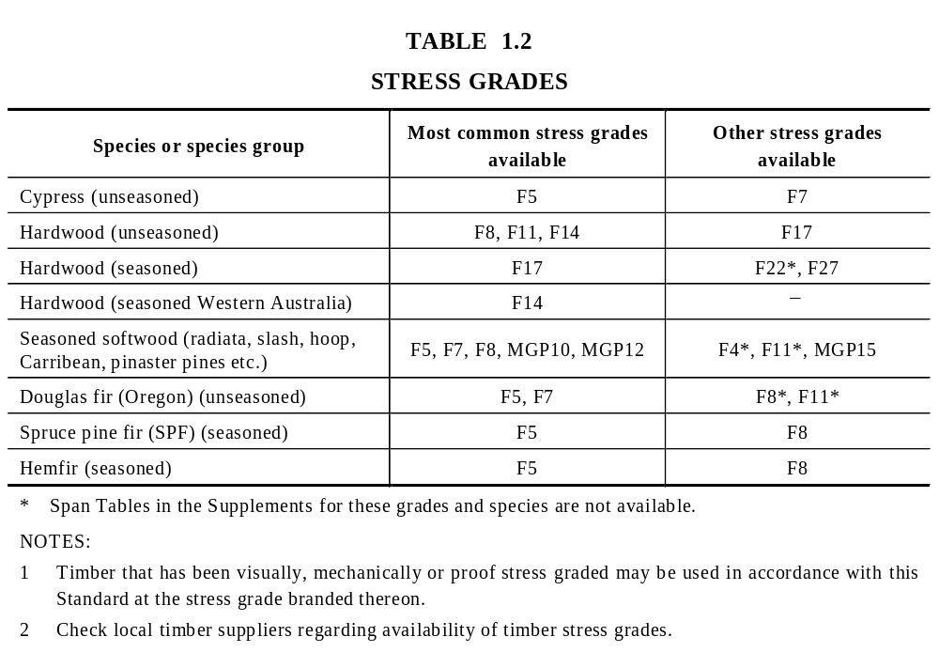

Slide 39
1.15 SIZE TOLERANCES
When using the Span Tables of the Supplements, the following maximum undersize tolerances on timber sizes shall be permitted:
  Unseasoned timber ⎯
    Up to and including F7 4 mm.
    F8 and above 3 mm.
  Seasoned timber ⎯ All stress grades 0 mm.
NOTE: When checking unseasoned timber dimensions on-site, allowance should be made for shrinkage, which may have occurred since milling.

Slide 40
1.16 ALTERNATIVE TIMBER DIMENSIONS
The alternative timber dimensions given by this Clause shall not apply to the Span Tables in the Supplements.
Where a timber dimension is stated in the clauses of this Standard, it refers to the usual minimum dimensions of seasoned timber. Alternative nominal dimensions for unseasoned timber and seasoned Western Australian hardwood shall be in accordance with Table 1.3.
The size tolerances given in Clause 1.15 are also applicable to these dimensions
A4

Slide 41
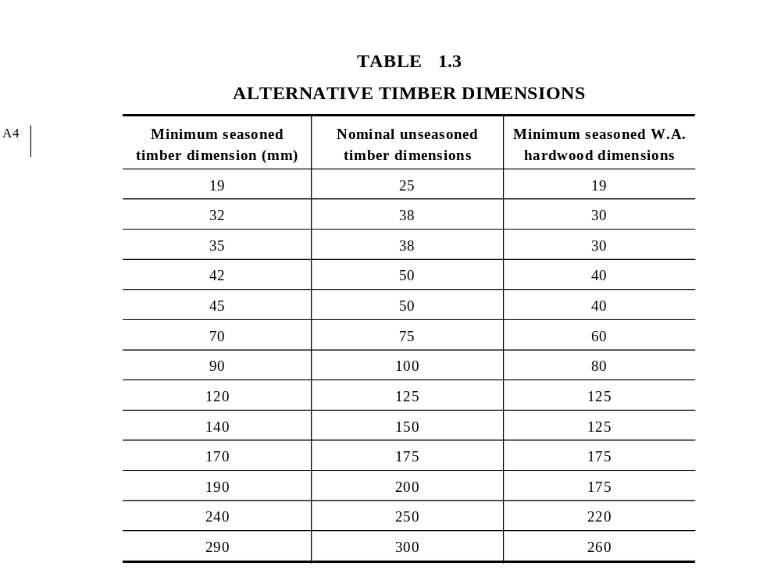
A4

Slide 42
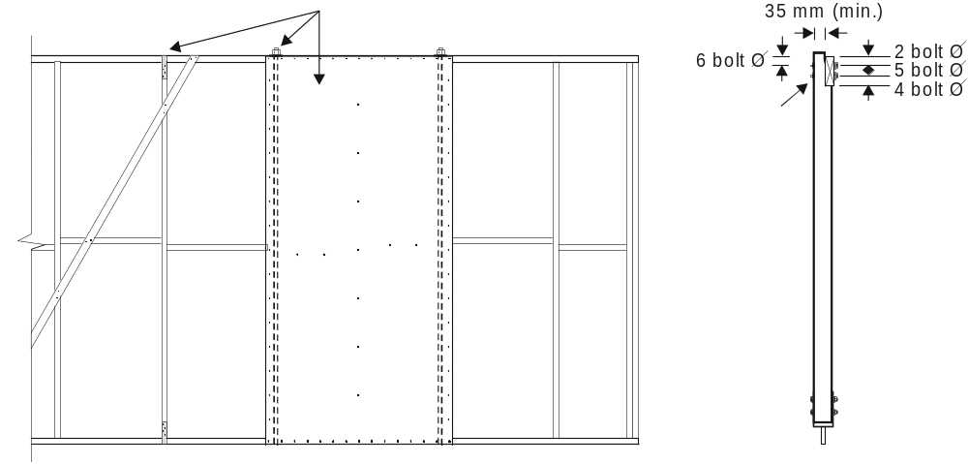
1. Bracing may affect top and/or bottom plate sizes and/or stud spacing.
2. Bolts or straps associated with braces or bracing sheets themselves may be able to be utilised for tie-down.
3. Tie-down methods may affect member sizes
Verandah beam
to post.
Table 9.20(i)

